Slide 1
McSOC:
A scripted 'SOC in a BOX' network deployment
Ronald Broberg
December 2016

Slide 2
McSOC: Executive Summary
Create a redeployable network architecture that can
  demonstrate SOC capabilities
  provide a platform to develop SOC solutions
  Be delivered as a training environment

Slide 3
McSOC: High Level Features
Infrastructure as Code
  Network Deployment and Configuration is Scripted
Self-Validation
  Continuous Monitoring
  Automated Testing
Capabilities Definition
  Capabilities Documentation bundle
Use Case Development
  Use Cases bundled

Slide 4
McSOC: Technology Guide
Open Source Components
  Minimize License Issues
  Maximize Re-usability
  Constraint: Glosses over Microsoft features of any enterprise network
Deployable to Multiple Visualization Hosts
  Develop on single server
  Deploy to Amazon AWS or Vmware
Automated Testing
  Deployed Project should be able to self-validate

Slide 5
Infrastructure Design

Slide 6
McSOC: Network Layout
Internet
DMZ
SOC
ENT SVR
DEV SVR
ENT WKS
DEV WKS

Slide 7
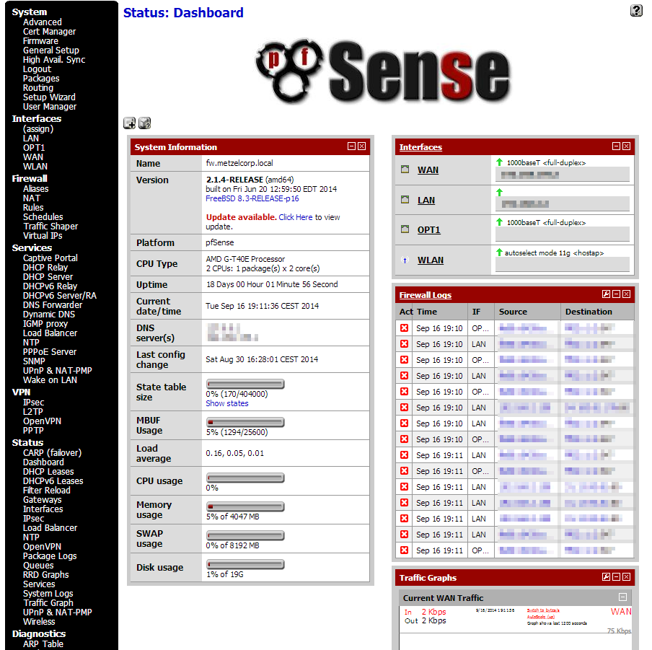
McSOC: - : ROUTERS
pfSense
  Firewall
  Routing
  SNMP
FreeBSD 10

Slide 8
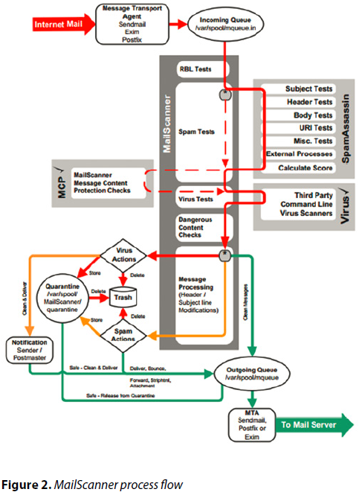
McSOC : DMZ : MAIL
Mail Transfer Agent
  Postfix
  MailScanner
  SpamAssassin
  ClamAV
Turnkey Debian 8 Jessie
https://www.ixsystems.com/blog/an-email-gateway-with-freebsd-to-prevent-malware-and-undesirable-messages/

Slide 9
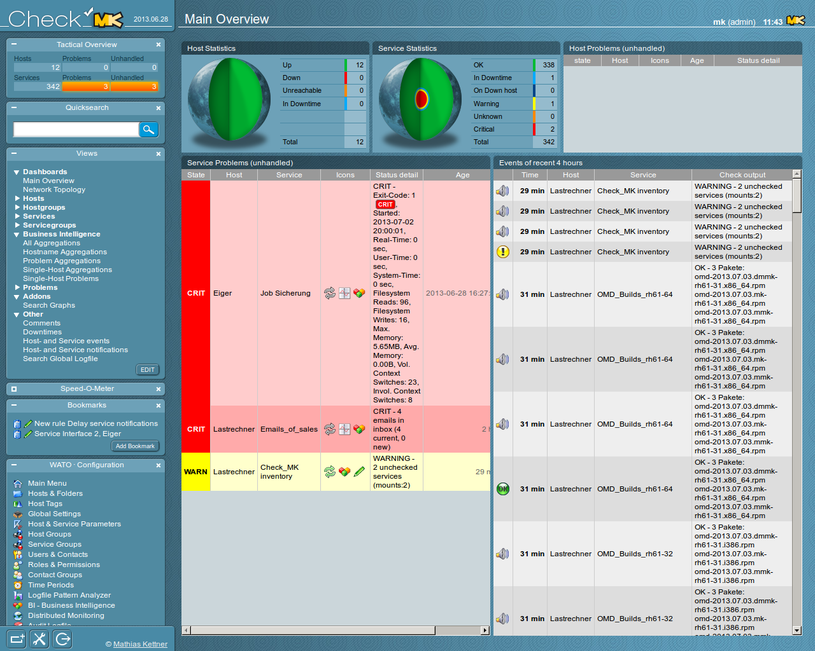
McSOC: SOC : NAGIOS
Network Monitor
  Check_MK
    Nagios Variant
    Liveevent Service
Ubuntu 16 Xenial

Slide 10
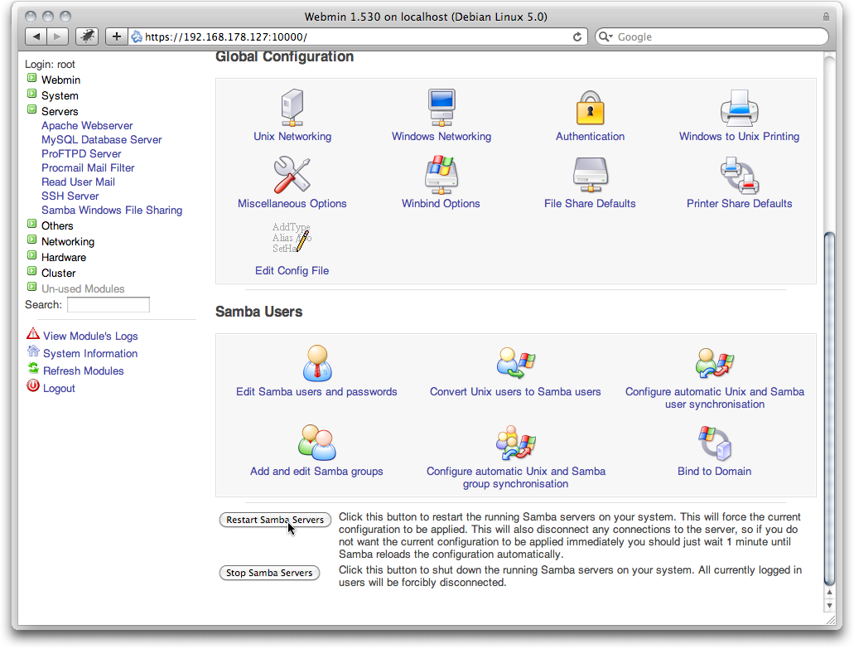
McSOC: ENTSVR : DC1
Domain Controller
  Samba4 Authentication
Mail Server
  PostFix
DNS Server
  Bind9
TurnKey Debian 8 Jessie

Slide 11
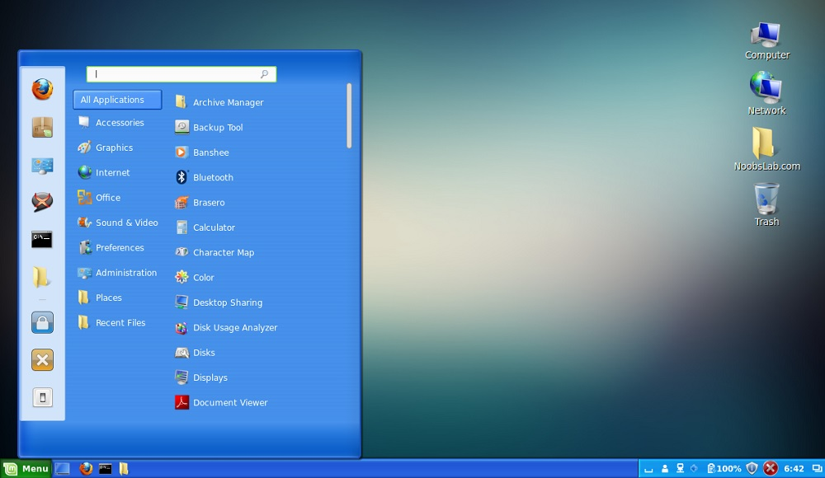
McSOC: ENTWKS : WKS101
Domain Client
  Samba4 Authentication
Mail Client
  PostFix
Web Browser
  Chrome ?
  Firefox ?
Mint Linux 14
Win 7 Look and Feel

Slide 12
Network Data Flow

Slide 13
McSOC: Inbound Email Flow
Postfix holds the mail upon receipt.
MailScanner scans the email in queue.
  SpamAssassin
  ClamAV
MailScanner re-queues the email and hands it over back to Postfix.
Postfix processes the email as necessary and delivers the mail to recipient.

